Slide 1
Introduction to HTML
Background

Slide 2
What is HTML?
HyperText Markup Language
Initially developed/described by Tim Berners-Lee in 1991
HTML is a markup language
Set of rules inferring structure
Meta data
Attempt at standardization
List of “HTML Tags” or elements
Maintained by the World Wide Web Consortium (W3C) and the Web Hypertext Application Technology Working Group (WHATWG)
Recommendations (or specifications)
Document Object Model (DOM)
W3C maintains XHTML, XML and other web protocols

Slide 3
What is HTML?
Version history
HTML draft (1991-1993)
HTML 2.x (1994-1997)
HTML 3.x (1995-1997)
HTML 4.x (1997-2000)
HTML 5.x (2008-2021)

Slide 4
What is XML?
Extensible Markup Language (XML)
Markup language
File format
Specification maintained by the W3C
Meta data tags to “describe” data
Matching open and close tags
Allows nesting of tags
Enables serialization and streaming
Can be used in conjunction with XML Schema Definition (XSD), Extensible Stylesheet Language Transformations (XSLT), and XML Query (XQuery)

Slide 5
What is XHTML?
Extensible HyperText Markup Language
An example of an XML markup language
Extends HTML
Intended to be more structured, stricter, yet ultimately more extendible
Version history
XHTML 1.0 (2000 initial, 2002 2nd edition)
XHTML 1.1 (2001 initial, 2010 2nd edition)
XHTML 1.2 (abandoned)
XHTML 2.0 (abandoned)
XHTML5 - XML-serialized HTML5 (2014 W3C Proposed Recommendation)

Slide 6
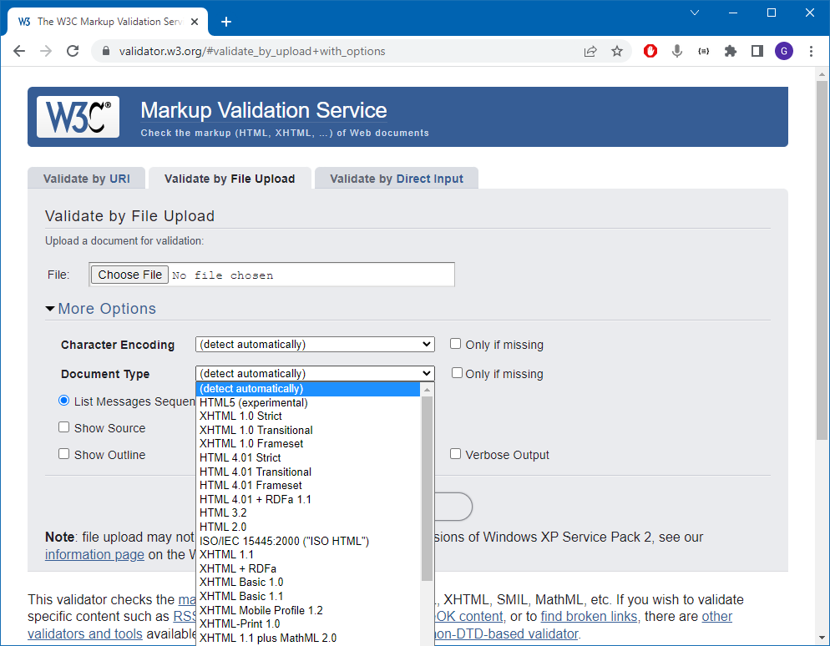
HTML and XHTML Validation
W3C Markup Validation Service
by URI
by File Upload
By Direct Input
Example <!DOCTYPE>
<!DOCTYPE html>
<!DOCTYPE HTML PUBLIC "-//W3C//DTD HTML 4.01 Transitional//EN" "http://www.w3.org/TR/html4/loose.dtd">
W3Schools <!DOCTYPE>

Slide 7
HTML5
Conflict between the W3C and WHATWG with WHATWG ultimately taking responsibility (2019) of the “Living Standard”
Some goals:
Quicker evolutionary response
Less ambiguity in invalid markup handling
Backward compatibility with HTML and XHTML
Extensibility to support Sematic Web applications
WHATWG HTML Living Standard

